Slide 1
Managing Arthritis When
Working in Cold Weather
Randy R. Weigel
Wyoming AgrAbility Project Director
University of Wyoming Extension
Amber D. Wolfe
AgrAbility Project Coordinator
Arthritis Foundation, Heartland Region

Slide 2
“Stay inside, walk in
a local mall, or
consider a three month vacation
to a warmer climate.”
A leading rheumatologist’s advice
Notes:
Arthritis affects approximately one-third of all adult ranch and farm operators. Arthritis can cause significant impairment to one’s mobility, dexterity, capacity to lift heavy objects and even emotional health due to unmanaged pain. But ranchers and farmers must climb ladders, mount tractors, feed livestock, and use heavy tools in all types of weather including cold and snow. So the question is,

Slide 3
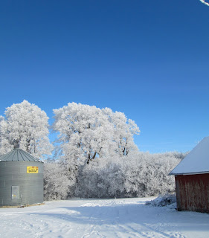
Does cold weather
worsen arthritis?
Research is unclear and contradictory
Limitations of research studies—self-reporting,
small sample size, inconsistent design,
uncontrolled variables, uniqueness of pain,
type of arthritis
Notes:
Studies finding a link between changes in weather and changes in joint symptoms have almost all relied on subjective measures of arthritis; that is, pain reported by patients and an increase or decrease of a weather feature (temperature, humidity, barometric pressure). For each study finding a relationship, there seems to be another study showing the opposite effect or no effect. It has not been proven that weather reliably affects arthritis; though it hasn’t been disproved either. There are many types of arthritis and many weather factors that could act in combination to have an impact on joint pain. There is also different levels of pain tolerance in those who experience arthritis pain.
Though science is unclear on the subject, just ask someone who lives with arthritis and they will tell you: it does! There are a few ideas on why this occurs.

Slide 4
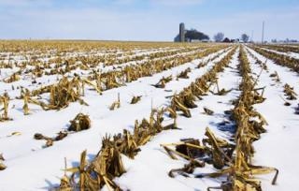
Possible explanations
for increased pain
Physiological – falling barometer, vasoconstriction
Physical – inactivity
Psychological – winter drop in mood, self-
fulfilling prophecy
Notes:
The most common one involves barometric pressure. Some researchers think that a drop in barometric pressure, which often occurs during cold, damp weather, allows tissues in joints to swell and put pressure on nerves causing pain.
A second hypothesis involves sympathetic nerves. These sympathetic nerves are part of the body’s system for maintaining its internal functioning without us having to think about it. When it is cold, these nerves constrict blood vessels in the limbs to minimize heat loss and help keep the body core warm. But the increased activation of these nerves around joints might also lead to an increase in the pain a person feels.
Shorter days and colder temperatures can also make us less active and immobility can make arthritis pain worse. During winter, many people lead a less active lifestyle and joints tend to stiffen up. This is commonly referred to as gelling, where your joints become “gelled” because you are sitting in one position too long and it causes pain and stiffness.
A winter drop in mood is common in many people and low mood may be linked to higher levels of perceived pain.
Finally, there is the self-fulfilling prophecy. We want to find a reason for the pain and so the weather is easy to blame. If people have convinced themselves there is a relationship between changing weather and pain…then when the barometer drops, clouds approach, winds pick up, they believe they should have an increase in pain, and they do!

Slide 5
Percentage of chronic pain patients
reporting symptom complaints influenced
by weather conditions. N = 70
Joint stiffness – 82% | Muscle ache/sore – 79% | Trouble sleeping – 75%
Muscle weakness – 74% | Poor circulation – 72% | Feel depressed – 67%
Feel anxious – 64% | Hot or cold spells – 59% | Feel angry – 59%
Headaches – 58% | Poor appetite – 49% | Upset stomach – 46%
Trouble breathing – 42% | Faintness – 41% | Chest pains – 34%
Shutty, M., Cundiff, G., & DeGood, D. (1992). Pain complaint and the weather: Weather sensitivity and symptom complaints
in chronic pain patients. Pain, 49, 199-204.
Notes:
Chronic pain patients frequently report that weather conditions affect their pain. In a study of pain complaint and weather, seventy chronic pain patients were asked to assess their weather sensitivity to meteorological variables defined by the National Weather Service. These variables included temperature (hot or cold), sudden weather changes, humidity (damp or dry), precipitation (rain or snow), thunderstorms, and sunlight. Temperature (87% reporting) and sudden weather changes (76% reporting) were the leading variables influencing these patients. (Study took place at University of Virginia Medical School.)
Though there is no evidence that cold weather and weather changes lead to joint damage, many health care providers believe that weather can enhance the pain symptoms.

Slide 6
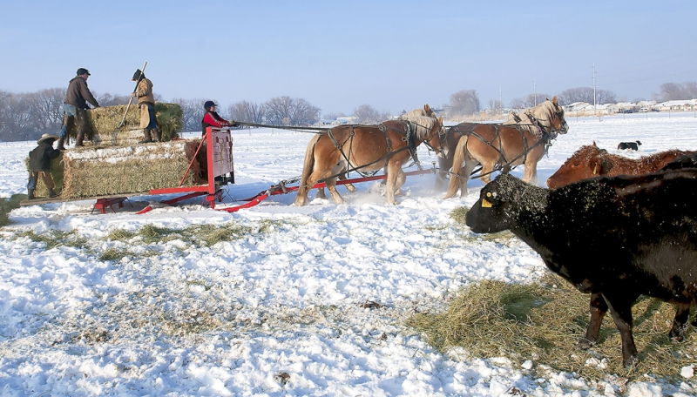
Cold is an occupational hazard
in agriculture
Disease flare-ups
Increase in injuries
Strains and sprains
Breathing issues
Notes:
Cold is an occupational hazard for farmers and ranchers that can lead to direct cold-related health problems such as hypothermia, frostbite or trench foot. In addition:
Conditions like arthritis and COPD can be made worse in cold environments. People with untreated hypertension have a higher blood pressure in winter than in summer.
Cold weather can decrease dexterity, mental skills, coordination and cause a general decline in performance that affects safety. The effects of cold on nerves, joints and muscles are factors which are likely to cause clumsiness, loss of manual dexterity and impairment of coordination and therefore increased risk of accidents. Accidents and falls can have serious consequences for arthritic joints. Falling on the affected joint…knee, hip, or hand…can often cause worsening of the arthritis. People with arthritis are at risk because the muscles supporting the affected joints are often weaker and less flexible. In addition the speed of mental reaction is affected by cold with considerable and progressive reduction of efficiency.
Working in cold weather can increase the risk of injuries to muscles and tendons, e.g., back strain. Cold decreases the power and duration of muscle contractions and cold muscles are notoriously liable to tears. That is why athletes need to “warm up”. Those performing heavy exertion activities outside should “warm up” The greater the exertion, the greater the risk and therefore the more vital the warm up.
Breathing cold, dry air can aggravate conditions such as bronchitis, emphysema, sinus irritation, or asthma.

Slide 7
What is cold stress?
Factors that increase danger from the cold
Air movement Wetness
Improper clothing Physical condition
Tired or dehydrated Medical conditions
Notes:
Factors that increase danger from the cold are these:
What constitutes cold stress and its effects can vary across different areas of the country. In regions that are not used to winter weather, near freezing temperatures are considered factors for “cold stress”. Increased wind speed also causes heat to leave the body more rapidly (wind chill effect). Wetness or dampness, even from body sweat, also facilitates heat loss from the body. Cold stress occurs by driving down the skin temperature, and eventually the internal body temperature. When the body is unable to warm itself, serious cold-related illnesses and injuries may occur, and permanent tissue damage and death may result. Extreme cold temperatures can affect the body in a number of ways…dehydration, numbness, shivering…in addition to frostbite, immersion foot, and hypothermia.

Slide 8
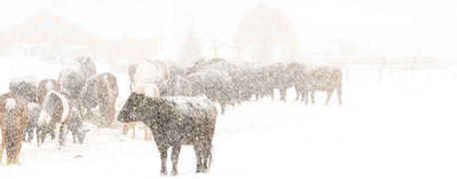
Workers are at increased
risk for cold stress due to…
Extreme conditions
Health risks
Being unprepared
Notes:
While workers in agriculture, construction, road repair or commercial fishing are often exposed to the most extreme risks, cold stress is not exclusive to outdoor workers. People who work in cold storage or food processing, was well as farmers and ranchers working in barns without heat, insulation or with lots of drafts can also be at risk if…
They are older,
In poor physical condition,
Not in good health…heart disease, diabetes, hypertension, asthma,
Work in wet or damp conditions,
Drinking alcohol or too much caffeine which increases the rate at which the body cools or smoking which decreases circulation,
Taking certain medications, beta-blockers for example, that also affects thermoregulation
Not be acclimated to cold conditions,
And of course, not wearing proper clothing—which we’ll cover shortly.

Slide 9
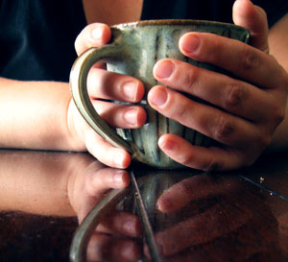
Ease the pain in the home
(what people with arthritis tell us)
Don’t scrimp on heat
Plug in some warmth
Preheat
Loosen up
Treat yourself
Notes:
Don’t scrimp on heat. Saving money by lowering the thermostat may not be the best option for those with arthritis. You may pay in other ways. Keep your home at a comfortable level.
Plug in some warmth. An electric blanket is effective for keeping you warm while resting or sleeping. A heating pad is helpful for localized areas where joints have become stiff. Keep your feet warm. When your feet get cold, your whole body feels cold. Wear wool socks, fleece slippers or leg warmers when you are sitting or lying down.
Preheat. Before driving your vehicle, preheat it. It may take you longer to get going but sitting in a warm vehicle beats shivering in a cold one. Also, one rancher warms her long johns in the dryer before dressing to leave the house. Sound strange? Not if you have arthritis.
Loosen up. It is important to keep moving. Exercise the affected joints before going out in cold weather. Regular exercise will not only loosen joints, but will help prevent winter weight gain that puts more stress on painful joints. In terms of type of exercise, make sure it is low impact. Swimming is best but not always available in rural areas. An exercise bike or an elliptical machine is easier on the joints than a treadmill. Avoid high impact exercises like jumping jacks, squats and lunges. Exercises that emphasize gentle, pain free movements are best.
Treat yourself. Hot beverages such as herbal tea or broth are soothing and warming. Some people also find that taking a warm bath at night just prior to going to bed helps during winter months. If available, regular massages can provide pain relief.
Topical creams may offer a soothing relief of pain symptoms by providing heat sensation. Some of them may contain an analgesic that can reduce pain levels. Topical creams will not cure arthritis or correct hand deformities.
Vitamin D – During winter months, the more we stay inside the less vitamin D we receive from the sun. Taking a vitamin D supplement could reduce the amount and severity of arthritic flares.
Some folks wear arthritic gloves which provide mild compression to enhance blood circulation that helps warm hands.

Slide 10
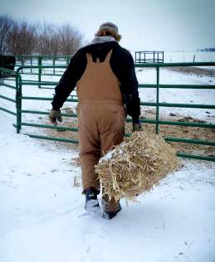
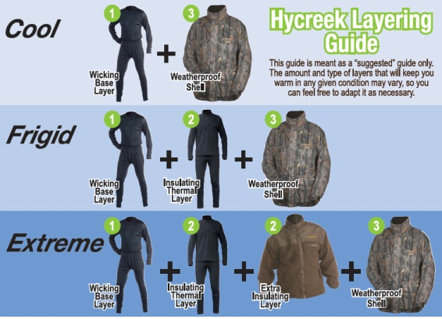
Work safely in the cold
Dressing for cold weather
http://www.youtube.com/watch?feature=player_detailpage&v=yho7a_Nhed0
Notes:
Unlike these Packer fans, layering is the preferred method of dressing for the cold. This “Dressing for cold weather” video demonstrates the concept of layering.
Again, wear a minimum of three layers of clothing: an outer layer that breaks the wind, a middle layer that retains insulation, and an inner layer that allows for ventilation. In some arthritic conditions though, if layers are too heavy or too tight, pain can increase. Also, cotton is not recommended for the inner layer as it does not wick moisture the way silk, polypropylene or wool does.
It is also important to keep a change of clothes available in case your clothes get wet or you sweat excessively.

Slide 11
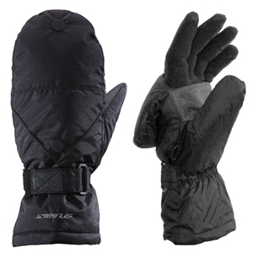
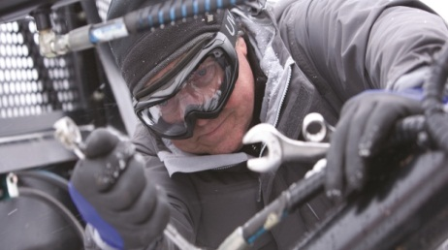
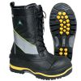
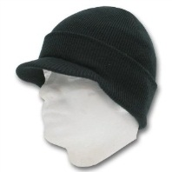
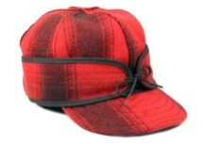
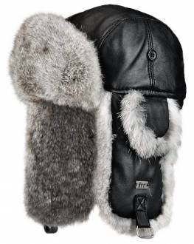
Additional considerations for
ranchers and farmers with arthritis
Notes:
Carry hand and foot warmers with you or keep a supply in the truck. They are an inexpensive way to stay warm for several hours.
Protect your hands with insulated gloves. Mittens may work better in very cold conditions and might be easier for those with arthritis in their hands. Some wear gloves under a pair of mittens for warmth and remove mittens to use gloved fingers as needed. Others use mitten/fingerless glove combos.
Protect your feet from cold and dampness with layered socks inside comfortable, insulated boots. Tight fitting boots restrict blood circulation and increase foot pain. Felt-lined, rubber bottomed, leather-topped boots with removable felt insoles are best suited for heavy work in cold since leather is porous, allowing the boots to “breathe” and let perspiration to evaporate. However, if work involves standing in water or slush, e.g., farming, waterproof boots are preferred. However, they prevent perspiration to escape and the socks will become wet more quickly. So extra socks need to be kept close by.
Protect your head and face. Though it is not clear how much heat loss occurs from the head and neck, there are three features that make them a major source of heat loss: the blood flow to the brain is large, the bone which surrounds the brain is a good conductor of heat, and the overlying scalp is thin and contains little insulating fat or other protection (bald heads). Warm headgear is essential. Caps work better than hoods as the fit more snugly. In certain conditions, facemasks may be needed.
Exposure of the eyes to winter conditions such as cold temperatures, wind, and intense glare caused by snow poses a variety of hazards. Injuries incurred from exposure to extreme cold range from eye pain and blurred, decreased, or double vision to severe sensitivity to light and even vision loss. Overexposure to glare can cause snow blindness, a corneal injury that leads to redness, swelling, or a dry, scratchy feeling in the eyes. Wind not only blows debris and snow into the eyes, but also can cause temperatures to feel far colder than they actually are, exacerbating dryness, discomfort, and injury. goggles may be needed by some outdoor workers in extreme conditions.

Slide 12
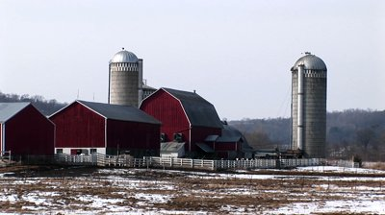
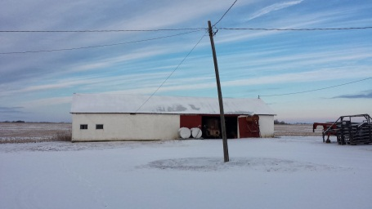
Safety at the work site
On-site source of heat
Heated shelter/vehicle
Reducing drafts
Use thermal insulating materials
Use thermal mats on cold floors
Warm up equipment, machinery, tools
Drive with care
Notes:
How can one reduce the risk of cold stress as well as work safely while reducing the pain of arthritis?
Use on-site sources of heat, such as air jets and radiant heaters, to provide warmth.
Make sure that a heated shelter or vehicle is available for anyone who has experienced prolonged exposure to wind chill temperatures below 20 degrees F.
Reduce drafty or windy areas in buildings or barns to shield work areas.
Use thermal insulating material on handles of equipment to reduce pain when touching cold objects. Touching cold objects with bare hands can exacerbate the pain. The same is true for cold, unprotected surfaces. Avoid sitting or kneeling on cold, unprotected surfaces. Use thermal mats. To reduce joint stiffness, alternate between sitting and standing. Sitting or standing for long periods of time can reduce blood circulation. Stretch frequently.
Warm up equipment, machinery, and tools or keep them in a heated building. Use care when handling fuels and solvents, especially gasoline. Rapid evaporation has a super cooling effect on the skin.
Arthritic joints react more slowly. Braking and shifting gears may take longer and steering can be painful. This is especially true in cold weather. Drive defensively and cautiously.

Slide 13
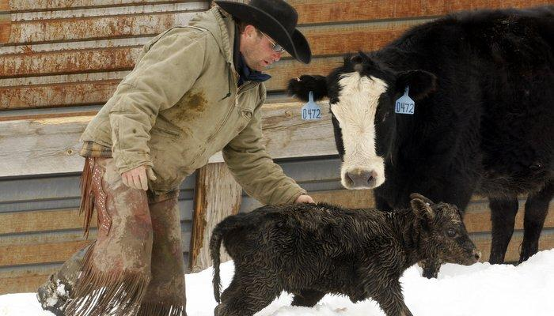
In summary: How to protect
yourself and your workers
Train yourself and workers for the cold and changing weather.
Adjust your work schedule to the cold and changing weather.
Use a buddy system.
Layer clothing.
Wear complete personal protective equipment (PPE).
Eat and drink hot or warm foods and liquids.
Take steps to manage arthritis pain
Notes:
Workers need to be training not only about cold-induced illnesses and injuries, but also to determine environmental or work site conditions that may cause cold stress. They should be especially trained in recognizing the signs of cold stress or cold-induced injuries like hypothermia and frostbite. Training might seem like a pain, but if not prepared, it will be a pain.
Don’t push yourself too much. Just because you have to work outside and it feels like stepping into a walk-in freezer, it doesn’t mean you have to face the frigid winds all day. Break a task into shifts so you can take frequent, short breaks in warm dry shelters.
Sure, you may want to be left to yourself while working. But, this is not the time to enjoy solitude. Get a partner and monitor each other for signs of cold stress. Don’t be stubborn because it is difficult to determine danger signs when you only have yourself to rely on.
In cold weather, the saying “less is more” surely does not hold true. Well, maybe partly true since wearing less clothes means getting exposed to more cold-stress-related risks. Remember that it’s better to go for several think layers instead of wearing just one thick layer.
Since there is no known cure for arthritis, education an awareness of pain management techniques are essential for farmers and ranchers to ensure their health and well-being.
You know you need it. Wear warm gloves, hats and hoods. If you get hot while working, just open your jacket. Don’t remove your hat or gloves. The key is in wearing clothing that can be adjusted to changing conditions.
You might have to say goodbye to hot coffee in the thermos. As mentioned earlier, drinking caffeinated and alcoholic beverages is not recommended while working in cold weather. Good news though, You can increase your caloric intake and feast on hot pasta dishes, soups and other foods rich in calories.
Since there is no known cure for arthritis, education and awareness of pain management techniques are considered the best practices for treating the disease. Encouraging individual weight loss, promoting behaviors that reduce shock to joints, and modifying worksites to eliminate high-risk tasks are significant to preventing joint damage.

Slide 14
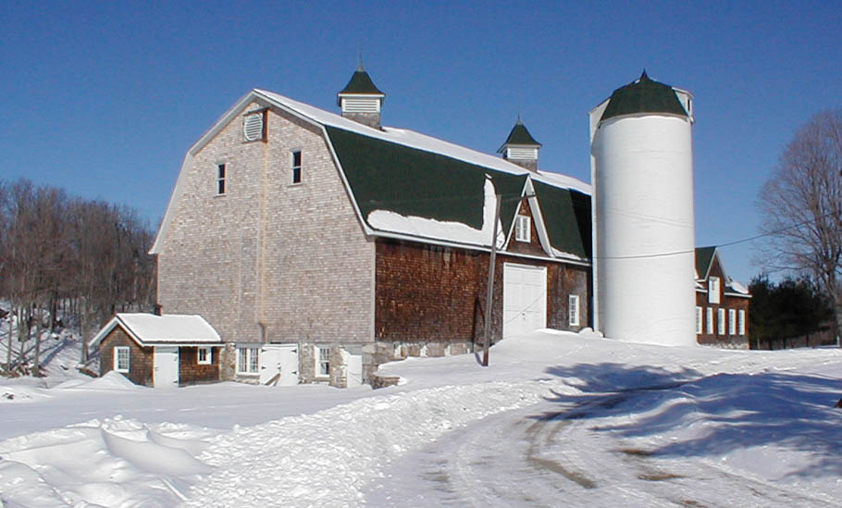
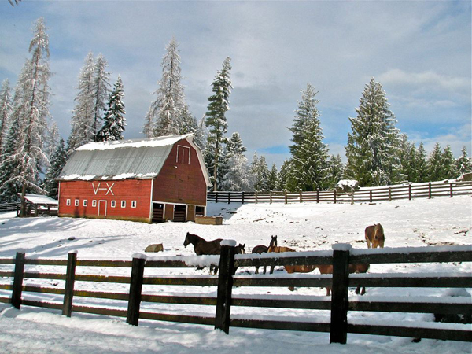
Additional Resources

Slide 15
Cold Work Injuries in Agriculture - Strategies for Prevention and Rehabilitation
Qiuqing Geng, Ph.D.
JTI-Swedish Institute of Agricultural and Environmental Engineering
Robert Stuthridge, Ph.D.
Purdue University
Department of Agricultural and Biological Engineering
Notes:
This archived webinar and pptx can be accessed from: http://agrability.org/Online-Training/archived/index.cfm

Slide 16
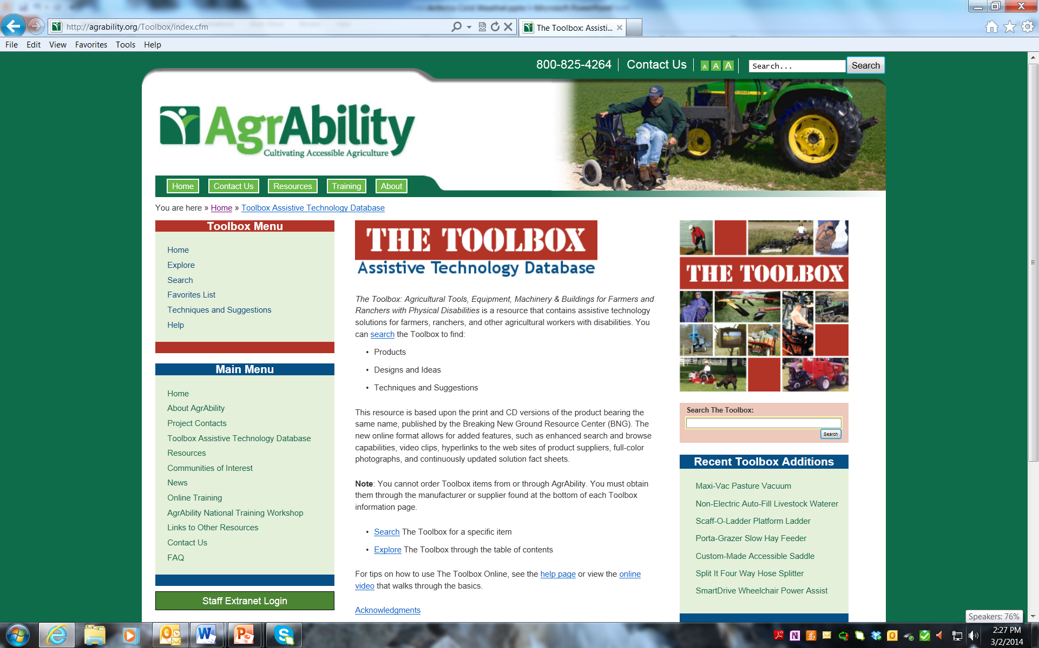
Notes:
The toolbox has many useful tools for reducing cold injury risk. It can be accessed from: http://agrability.org/Toolbox/index.cfm

Slide 17
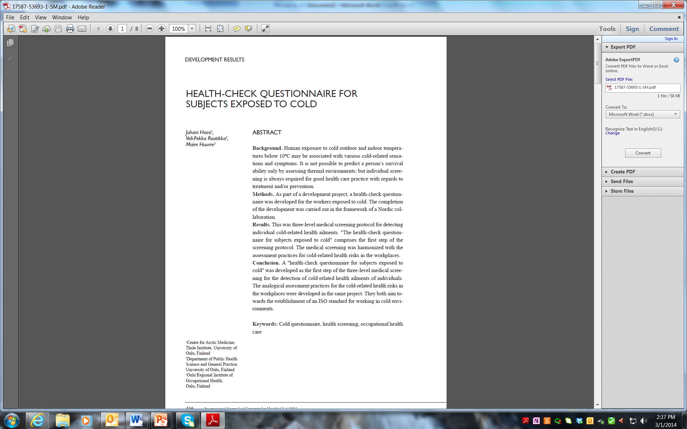
Notes:
A health-check questionnaire for subjects exposed to cold was developed as a medical screening for detection of cold-related health ailments of individuals. It can be accessed at: http://journals.co-action.net/index.php/ijch/article/viewFile/17587/20035. This research provided the benchmark for the International Standard ISO 15743, Ergonomics of the thermal environment – Cold workplaces – Risk assessment and management. Single use license only is available from the American National Standards Institute.

Slide 18
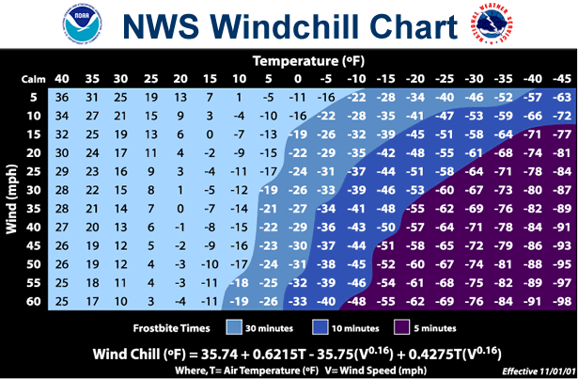
Notes:
The new windchill chart from NOAA and National Weather Service is available at: http://www.nws.noaa.gov/om/windchill/images/windchillchart3.pdf

Slide 19
Additional online resources
Cold Environments – Working in the Cold
Canadian Centre for Occupational Safety and Health
http://www.ccohs.ca/oshanswers/phys_agents/cold_working.html
Cold Stress Guide
Occupational Safety and Health Administration
https://www.osha.gov/SLTC/emergencypreparedness/guides/cold.html
Working Safely in the Cold
New Jersey Department of Health and Senior Services
http://www.nj.gov/health/surv/documents/coldfact.pdf
Cold-Related Conditions and Agriculture
eXtension Ag Safety and Health
http://www.extension.org/pages/66813/cold-related-conditions-and-agriculture

Slide 20
Thank you!
Notes:
The cold of winter is the time of year that many with arthritis dread. Preventing cold weather arthritis pain can be challenging. However, by using the suggestions provided and learning more about managing arthritis from Arthritis and Agriculture: www.arthritis-ag.org, ranchers and farmers with arthritis can work safely outdoors while managing their pain.

